Slide 1
ISI Integrated Ministry Model
Saturation - through Cooperation.
Notes:
1

Slide 2
Vision-Driven Ministry
Mission: International Students, Inc. exists to share Christ’s love with international students and equip them for effective service in cooperation with the local church and others.
Vision: To see every international
student befriended, led to a personal
relationship with Jesus Christ, and
discipled for His service.
Notes:
2
Effective ministry is “vision-driven ministry.” The Mission of ISI is to share Christ’s love with international students and equip them for effective service in cooperation with the local church and others. The Vision of ISI is to see every international student befriended, led to a personal relationship with Jesus Christ, and discipled for His service.

Slide 3
Goals:
Saturation: Providing every international student the opportunity to see and hear the claims of Jesus Christ clearly presented in the context of a genuine, Christ-directed relationship.
Replication: Developing mature
ministries that intentionally
replicate themselves.
Notes:
3
Goals further define what we are trying to achieve and give us a way to evaluate progress and effectiveness. The ministry goals of ISI are to achieve “saturation” (Providing every international student the opportunity to see and hear the claims of Jesus Christ clearly presented in the context of a genuine, Christ-directed relationship) as well as to achieve “replication” (Developing mature ministries that intentionally replicate themselves).

Slide 4
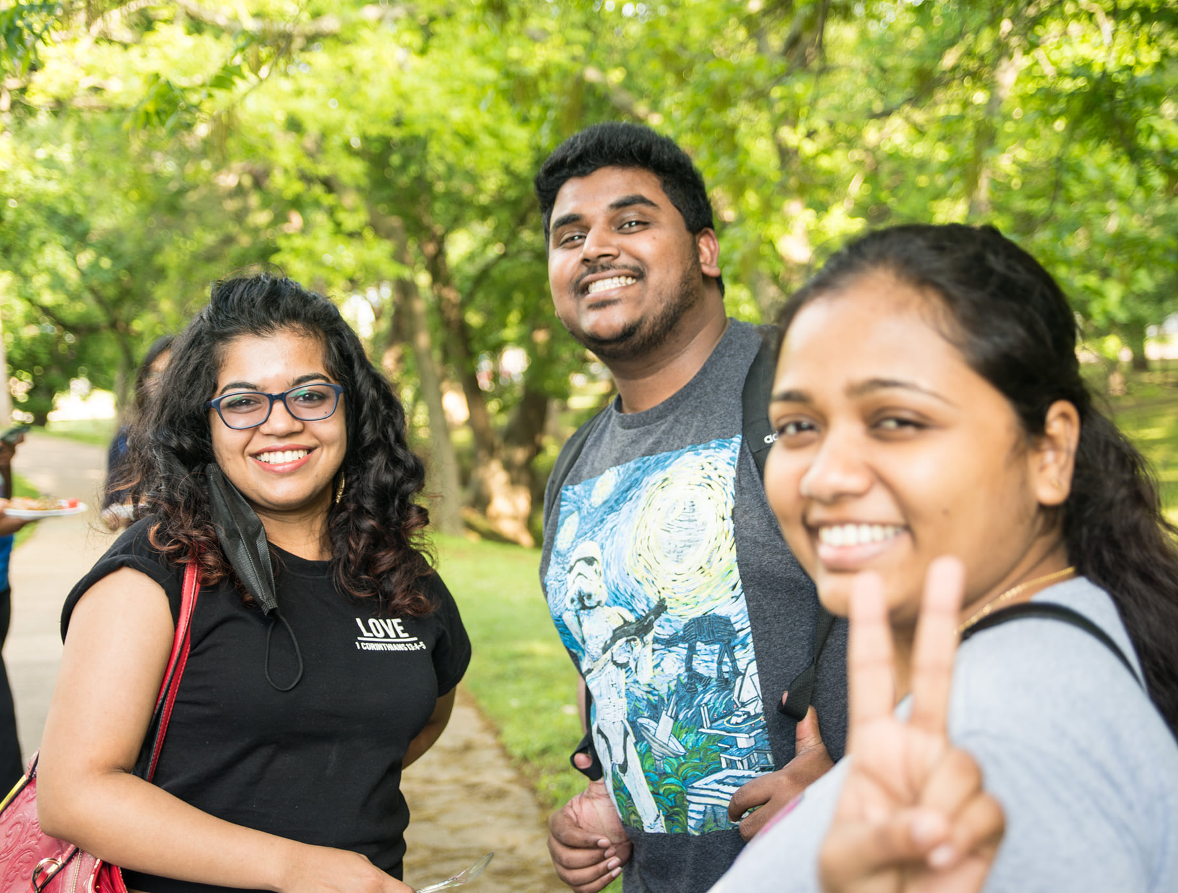
ISI’s Mobilization Strategies…
1) Campus Ministry
a) Equipped to equip
b) Dedicated team (focused,
long-term investment)
c) Staff presence (24/7)
d) Resident community
(“body life”)
Notes:
4
ISI is in the business of developing and replicating effective international student ministry strategies. Presently, ISI is deploying the following three ministry models: the Campus Ministry model, the Church Mobilization model, and the Student Mobilization model.
ISI’s Campus Ministry model consists of a team of ISI staff and volunteers working together to reach and disciple international students on a university or college campus.
Strengths of the Campus Ministry model include:
A ministry team that is specifically equipped for international student outreach and discipleship.
A dedicated team with high commitment to the development and success of the campus ministry.
High availability of ISI staff to international students on the campus.
Opportunity for international students to experience “resident community”, or Christian “body life,” right on their campus.

Slide 5
ISI’s Mobilization Strategies…
2) Church Mobilization
a) Volunteer mobilization
b) Global missions vision
c) Corporate worship
experience
d) Future generations
Notes:
5
ISI’s Church Mobilization strategy, on the other hand, is dedicated to equipping and mobilizing local churches and lay volunteers to help reach international students throughout their community with the love and message of Jesus Christ.
Strengths of this approach include:
ISM acceleration through mobilization of significant numbers of local area volunteers for service and outreach to international students.
Growth of vision for global missions among those churches participating in ISM.
Opportunity for international students to experience the life-changing impact of corporate worship within the local church.
Potential for raising future generations of ISM workers by involving the children and youth within those local churches.

Slide 6
ISI’s Mobilization Strategies…
3) Student Mobilization
a) Availability (time, energy, passion)
b) Accessibility (they’re there!)
c) Acceleration (next generation)
Notes:
6
ISI’s Student Mobilization strategy focuses on equipping and mobilizing Christian students to reach the international students throughout their campus and community.
Strengths of this model include:
Higher levels of involvement by Christian students in ISM due to greater discretionary time, more energy, and youthful vision and passion for ministry.
Greater accessibility to international students on a campus or community due to the Christian student’s residence or daily presence on that campus or community.
Significant potential for ISM replication and acceleration tomorrow – by nurturing vision and providing ministry experience to Christian students today.

Slide 7
Integrated Ministry Model
Campus
Ministry
Church
Mobilization
International
Students befriended,
led to a personal relation-
ship with Jesus Christ,
and discipled for
His service.
Interdependent
Synergistic
Nations
Nations
Student
Mobilization
Notes:
7
No ministry strategy is complete or sufficient in and of itself. The key to ministry saturation (reaching every international student) is ministry cooperation (God’s people working together to achieve a common goal). Ministry acceleration is possible, and saturation is achievable as ministry teams function interdependently, producing synergistic outcomes (where the sum of the unified parts is greater than the sum of the individual parts). As ISI’s Campus Ministry, Church Mobilization, and Student Mobilization strategies work together to reach international students throughout a community, more students will be befriended, led to a personal relationship with Jesus Christ, and discipled for His service – and saturation will be achievable. These students, in turn, equipped with a Christian world view, practical ministry skills, and global-impact vision, will become a powerful force in the world toward completing the task of reaching all nations.

Slide 8
ISI’s Integrated Ministry Model
Saturation - through Cooperation.
Notes:
8
This, in essence, is ISI’s integrated ministry strategy: God’s people working together to achieve maximum local ISM mobilization, resulting in the greatest global-missions impact possible.
Jesus said, in Matthew 24:14, “And this gospel of the kingdom shall be preached in the whole world for a witness to all nations, and then the end shall come.”
Thank you for joining the ISI team as we work together in cooperation – to achieve saturation. It is a privilege to co-labor with you.

